Slide 1

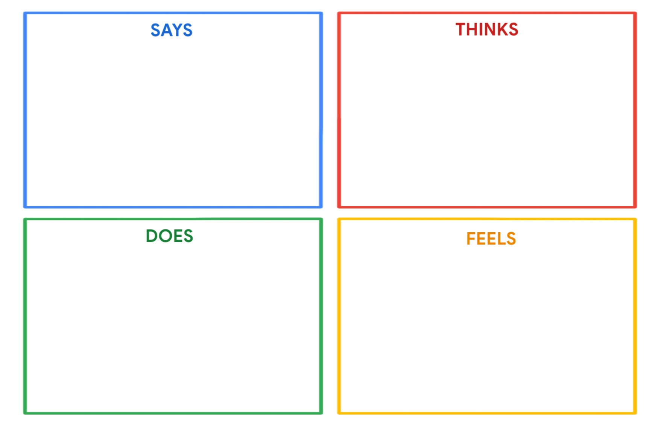
Mohamed Abdullah
"I prioritize staying fit and leading an active lifestyle."
"I enjoy reading about history and politics in my free time."
"I'm a dedicated soccer player who loves the game."
"I want to support my children's programming skills development."
"How can I balance my busy schedule to stay fit and be there for my family?"
"I'm curious about history and politics and want to continue learning."
"Documentaries provide valuable information and insights."
"How can I best support my kids' programming education and growth?"
He spends his leisure time in reading.
He plays soccer for entertainment.
He watches documentaries to expand his knowledge and awareness.
Mohamed supports his children's programming skills by providing resources
Professionally, he works on technology projects aimed at solving real-world problems.
Mohamed values staying fit and active and finds it important for his well-being.
Soccer brings him joy and helps him stay connected to his passion for sports.
Watching documentaries sparks a sense of curiosity and learning.
He prides himself on fostering his children's programming skills.

